Slide 1
Wireless Building Power Monitor
Project Review
Summer 2012
Mentor: Professor Thomas B. Jones

Slide 2
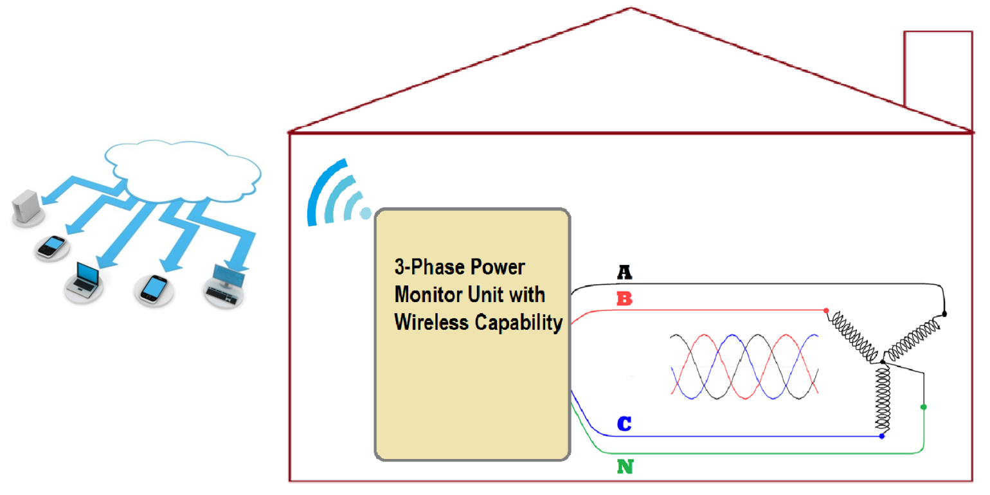
System Overview
Project Goal: Develop a system to remotely monitor power quality.
Remotely detect abnormalities in the power system
Ease of access to time-critical information
Help technicians maintain overall system integrity

Slide 3
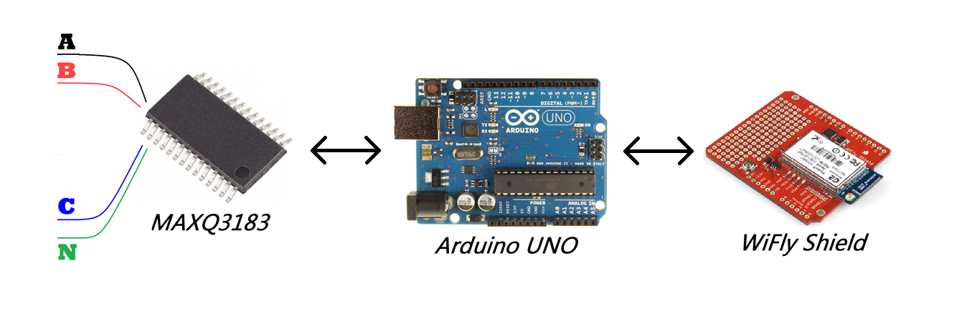
Power Monitoring Unit
Capable of measuring 3-phase (3 or 4 wire) circuits.
Able to run autonomously for reasonably long periods of time to gather useful data.
Transmits data wirelessly for storage and display.

Slide 4
Summer Work
Designed and implemented the supporting circuitry for the metering chip (Maxim MAXQ3183).

Slide 5
Summer Work
Designed and implemented the supporting circuitry for the metering chip (Maxim MAXQ3183).
Coded the Arduino to interface with the Maxim chip.

Slide 6
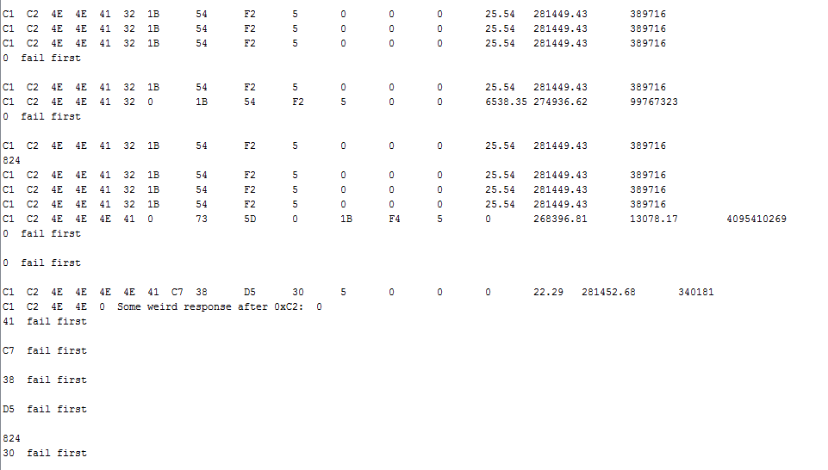
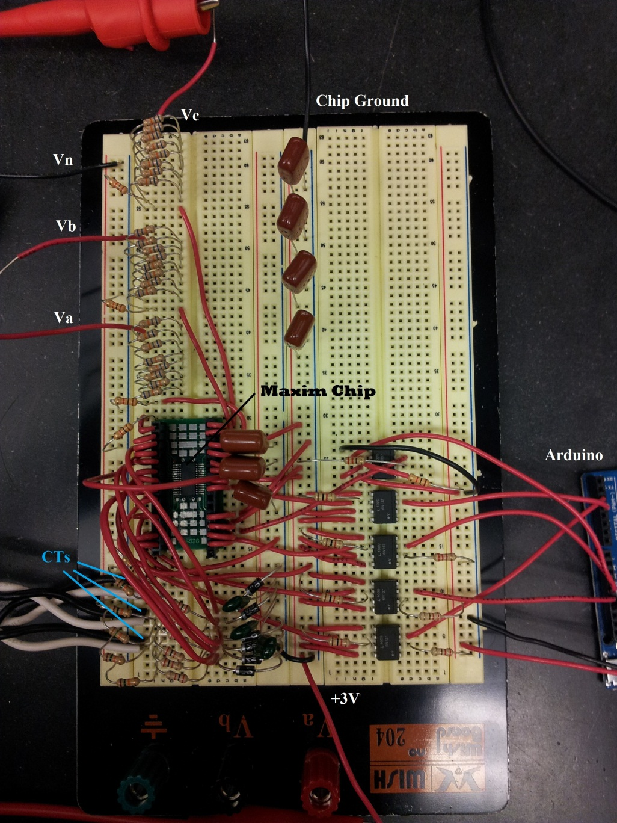

Slide 7
Summer Work
Designed and implemented the supporting circuitry for the metering chip (Maxim MAXQ3183).
Coded the Arduino to interface with the Maxim chip.
Soldered the custom PCB and mounted the entire circuit in a box.
Tested the wireless capabilities of the WiFly Shield
Wrote a simple initial Java program to mimic the final operation.

Slide 8
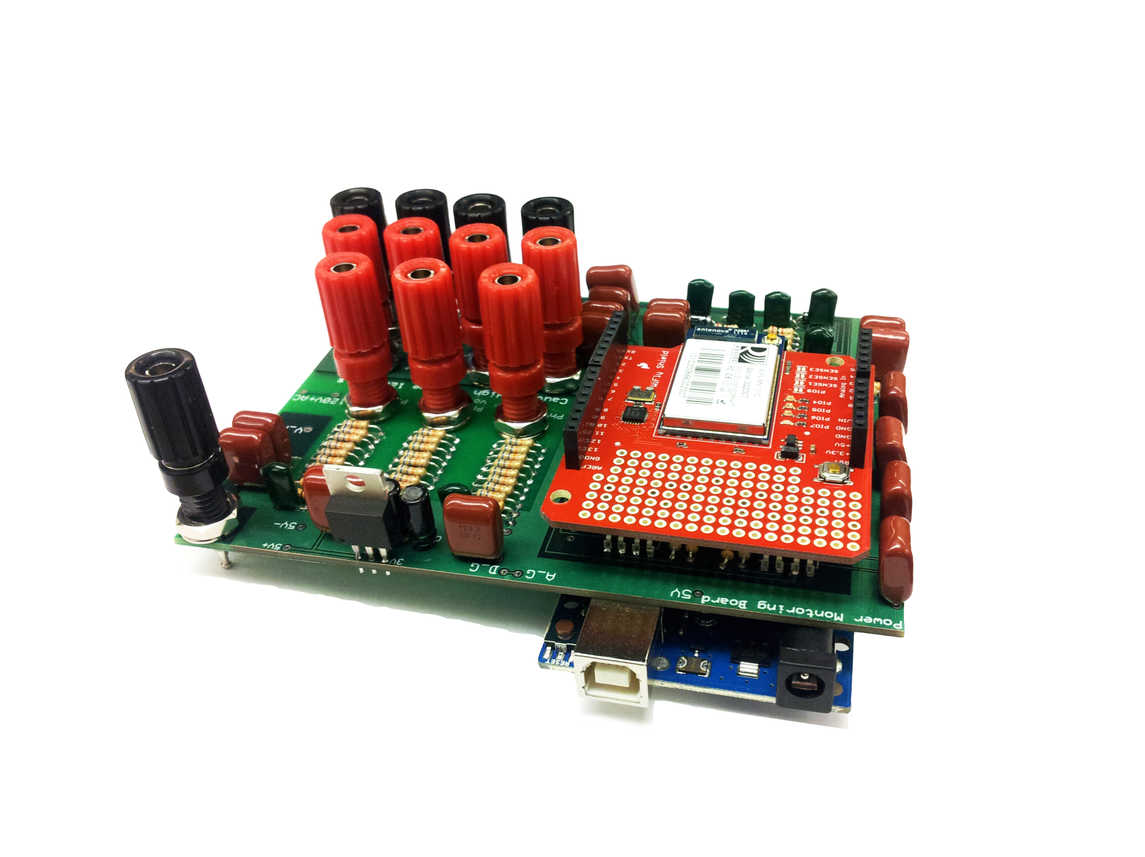

Slide 9
Summer Work
Designed and implemented the supporting circuitry for the metering chip (Maxim MAXQ3183).
Coded the Arduino to interface with the Maxim chip.
Soldered the custom PCB and mounted the entire circuit in a box.
Started testing the wireless capabilities of the WiFly Shield.
Wrote a simple initial Java program to mimic the final operation.

Slide 10
Summer Work
Designed and implemented the supporting circuitry for the metering chip (Maxim MAXQ3183).
Coded the Arduino to interface with the Maxim chip.
Soldered the custom PCB and mounted the entire circuit in a box.
Started testing the wireless capabilities of the WiFly Shield.
Wrote a simple initial Java program to mimic the final operation.

Slide 11
Going Forward
The security protocol WPA2-Enterprise, used by UR_Connected, is not supported by the WiFly Shield.
Douglas Bentley is currently trying to set up a temporary network with WPA2-PSK security protocol.
Another method is to have an intermediate computer/server between the Power Monitoring Unit and the internet.
The Arduino would only talk to this server.
Limitations on the range of the WiFly shield.
Implementing the rest of the measurements (Harmonics, THD, Fundamental values)
A prettier GUI.
Data storing
Charts/Graphs for displaying data.
A nicer package/box.

